Slide 1
CSCE 5580 – Computer Networks Instructor: Tao Wang

Slide 2

Chapter 3: roadmap
Transport-layer services
Multiplexing and demultiplexing
Connectionless transport: UDP
Principles of reliable data transfer
Connection-oriented transport: TCP
segment structure
reliable data transfer
flow control
connection management
Principles of congestion control
TCP congestion control

Slide 3
TCP: overview RFCs: 793,1122, 2018, 5681, 7323
point-to-point:
one sender, one receiver
reliable, in-order byte steam:
no “message boundaries"
full duplex data:
bi-directional data flow in same connection
MSS: maximum segment size
cumulative ACKs
pipelining:
TCP congestion and flow control set window size
connection-oriented:
handshaking (exchange of control messages) initializes sender, receiver state before data exchange
flow controlled:
sender will not overwhelm receiver
Notes:
Typical MSS is 1460 bytes

Slide 4
TCP segment structure
32 bits
source port #
dest port #
segment seq #: counting bytes of data into bytestream (not segments!)
ACK: seq # of next expected byte; A bit: this is an ACK
sequence number
acknowledgement number
length (of TCP header)
head
len
not
used
A
P
S
receive window
flow control: # bytes receiver willing to accept
C
E
U
R
F
Internet checksum
checksum
Urg data pointer
options (variable length)
C, E: congestion notification
TCP options
application
data
(variable length)
data sent by application into TCP socket
RST, SYN, FIN: connection management

Slide 5
UDP segment structure
32 bits
source port #
dest port #
length
checksum
application
data
(payload)
UDP segment format

Slide 6
TCP sequence numbers, ACKs
outgoing segment from sender
Sequence numbers:
byte stream “number” of first byte in segment’s data
source port #
dest port #
sequence number
acknowledgement number
rwnd
checksum
urg pointer
window size
N
Acknowledgements:
seq # of next byte expected from other side
cumulative ACK
sender sequence number space
sent
ACKed
sent, not-yet ACKed
(“in-flight”)
usable
but not
yet sent
not
usable
Q: how receiver handles out-of-order segments
A: TCP spec doesn’t say, - up to implementor
outgoing segment from receiver
source port #
dest port #
sequence number
acknowledgement number
A
rwnd
checksum
urg pointer

Slide 7

TCP sequence numbers, ACKs
Host A
Host B
User types‘C’
Seq=42, ACK=79, data = ‘C’
host ACKs receipt of‘C’, echoes back ‘C’
Seq=79, ACK=43, data = ‘C’
host ACKs receipt of echoed ‘C’
Seq=43, ACK=80
simple telnet scenario
Notes:
The key thing to note here is that the ACK number (43) on the B-to-A segment is one more than the sequence number (42) on the A-to-B segment that triggered that ACK
Similarly, the ACK number (80) on the last A-to-B segment is one more than the sequence number (79) on the B-to-A segment that triggered that ACK

Slide 8
TCP round trip time, timeout
Q: how to set TCP timeout value?
longer than RTT, but RTT varies!
too short: premature timeout, unnecessary retransmissions
too long: slow reaction to segment loss
Q: how to estimate RTT?
SampleRTT:measured time from segment transmission until ACK receipt
ignore retransmissions
SampleRTT will vary, want estimated RTT “smoother”
average several recent measurements, not just current SampleRTT

Slide 9
TCP round trip time, timeout
EstimatedRTT = (1- α)*EstimatedRTT + α*SampleRTT
exponential weighted moving average (EWMA)
influence of past sample decreases exponentially fast
typical value: α = 0.125
RTT: gaia.cs.umass.edu to fantasia.eurecom.fr
RTT (milliseconds)
sampleRTT
EstimatedRTT
time (seconds)

Slide 10
TCP Sender (simplified)
event: data received from application
create segment with seq #
seq # is byte-stream number of first data byte in segment
start timer if not already running
think of timer as for oldest unACKed segment
expiration interval: TimeOutInterval
event: timeout
retransmit segment that caused timeout
restart timer
event: ACK received
if ACK acknowledges previously unACKed segments
update what is known to be ACKed
start timer if there are still unACKed segments

Slide 11
TCP Sender: events/actions [RFC 5681]
Event at Sender
data received from application
Timeout
ACK received
TCP Sender action
create segment with seq #
start timer if not already running
retransmit segment that
restart timer
update what is known to be ACKed
start timer if there are still unACKed
segments

Slide 12
TCP Receiver: ACK generation [RFC 5681]
Event at receiver
arrival of in-order segment with
expected seq #. All data up to
expected seq # already ACKed
arrival of in-order segment with
expected seq #. One other
segment has ACK pending
arrival of out-of-order segment
higher-than-expect seq. # .
Gap detected
arrival of segment that
partially or completely fills gap
TCP receiver action
delayed ACK. Wait up to 500ms
for next segment. If no next segment,
send ACK
immediately send single cumulative
ACK, ACKing both in-order segments
immediately send duplicate ACK,
indicating seq. # of next expected byte
immediate send ACK, provided that
segment starts at lower end of gap
Notes:
Rather than immediately Acknowledging this segment, many TCP implementations will wait for half a second for another in-order segment to arrive, and then generate a single cumulative ACK for both segments – thus decreasing the amount of ACK traffic. The arrival of this second in-order segment and the cumulative ACK generation that covers both segments is the second row in this table.

Slide 13
TCP: retransmission scenarios
Host A
Host B
Host A
Host B
SendBase=92
Seq=92, 8 bytes of data
Seq=92, 8 bytes of data
timeout
timeout
Seq=100, 20 bytes of data
ACK=100
X
ACK=100
ACK=120
Seq=92, 8 bytes of data
Seq=92, 8
bytes of data
SendBase=100
send cumulative
ACK for 120
SendBase=120
ACK=100
ACK=120
SendBase=120
lost ACK scenario
premature timeout

Slide 14
TCP: retransmission scenarios
Host A
Host B
Seq=92, 8 bytes of data
Seq=100, 20 bytes of data
ACK=100
X
ACK=120
Seq=120, 15 bytes of data
cumulative ACK covers for earlier lost ACK
Notes:
One ack is required 120 ack contains al the previous packages.

Slide 15

TCP fast retransmit
Host A
Host B
TCP fast retransmit
if sender receives 3 additional ACKs for same data (“triple duplicate ACKs”), resend unACKed segment with smallest seq #
likely that unACKed segment lost, so don’t wait for timeout
Seq=92, 8 bytes of data
Seq=100, 20 bytes of data
X
ACK=100
timeout
ACK=100
ACK=100
Receipt of three duplicate ACKs indicates 3 segments received after a missing segment – lost segment is likely. So retransmit!
ACK=100
Seq=100, 20 bytes of data

Slide 16
Chapter 3: roadmap
Transport-layer services
Multiplexing and demultiplexing
Connectionless transport: UDP
Principles of reliable data transfer
Connection-oriented transport: TCP
segment structure
reliable data transfer
flow control
connection management
Principles of congestion control
TCP congestion control

Slide 17
TCP flow control
application
process
Q: What happens if network layer delivers data faster than application layer removes data from socket buffers?
Application removing data from TCP socket buffers
TCP socket
receiver buffers
TCP
code
Network layer delivering IP datagram payload into TCP socket buffers
IP
code
from sender
receiver protocol stack

Slide 18


TCP flow control
application
process
Q: What happens if network layer delivers data faster than application layer removes data from socket buffers?
Application removing data from TCP socket buffers
TCP socket
receiver buffers
TCP
code
Network layer delivering IP datagram payload into TCP socket buffers
IP
code
from sender
receiver protocol stack

Slide 19
TCP flow control
application
process
Q: What happens if network layer delivers data faster than application layer removes data from socket buffers?
Application removing data from TCP socket buffers
TCP socket
receiver buffers
TCP
code
receive window
flow control: # bytes receiver willing to accept
IP
code
from sender
receiver protocol stack

Slide 20
TCP flow control
application
process
Q: What happens if network layer delivers data faster than application layer removes data from socket buffers?
Application removing data from TCP socket buffers
TCP socket
receiver buffers
TCP
code
flow control
receiver controls sender, so sender won’t overflow receiver’s buffer by transmitting too much, too fast
IP
code
from sender
receiver protocol stack

Slide 21
TCP flow control
TCP receiver “advertises” free buffer space in rwnd field in TCP header
RcvBuffer size set via socket options (typical default is 4096 bytes)
many operating systems auto-adjust RcvBuffer
sender limits amount of unACKed (“in-flight”) data to received rwnd
guarantees receive buffer will not overflow
to application process
RcvBuffer
buffered data
rwnd
free buffer space
TCP segment payloads
TCP receiver-side buffering

Slide 22
TCP flow control
flow control: # bytes receiver willing to accept
TCP receiver “advertises” free buffer space in rwnd field in TCP header
RcvBuffer size set via socket options (typical default is 4096 bytes)
many operating systems auto-adjust RcvBuffer
sender limits amount of unACKed (“in-flight”) data to received rwnd
guarantees receive buffer will not overflow
receive window
TCP segment format

Slide 23
TCP connection management
before exchanging data, sender/receiver “handshake”:
agree to establish connection (each knowing the other willing to establish connection)
agree on connection parameters (e.g., starting seq #s)
application
application
connection state: ESTAB
connection variables:
seq # client-to-server
server-to-client
rcvBuffer size
at server,client
connection state: ESTAB
connection Variables:
seq # client-to-server
server-to-client
rcvBuffer size
at server,client
network
network
Socket clientSocket =
newSocket("hostname","port number");
Socket connectionSocket = welcomeSocket.accept();

Slide 24


Agreeing to establish a connection
2-way handshake:
Q: will 2-way handshake always work in network?
variable delays
retransmitted messages (e.g. req_conn(x)) due to message loss
message reordering
can’t “see” other side
Let’s talk
ESTAB
OK
ESTAB
choose x
req_conn(x)
ESTAB
acc_conn(x)
ESTAB

Slide 25
TCP 3-way handshake
Server state
Client state
serverSocket = socket(AF_INET,SOCK_STREAM)
serverSocket.bind((‘’,serverPort))
serverSocket.listen(1)
connectionSocket, addr = serverSocket.accept()
clientSocket = socket(AF_INET, SOCK_STREAM)
LISTEN
clientSocket.connect((serverName,serverPort))
LISTEN
choose init seq num, x
send TCP SYN msg
SYNSENT
SYNbit=1, Seq=x
choose init seq num, y
send TCP SYNACK
msg, acking SYN
SYN RCVD
SYNbit=1, Seq=y
ACKbit=1; ACKnum=x+1
received SYNACK(x)
indicates server is live;
send ACK for SYNACK;
this segment may contain
client-to-server data
ESTAB
ACKbit=1, ACKnum=y+1
received ACK(y)
indicates client is live
ESTAB

Slide 26
Closing a TCP connection
client, server each close their side of connection
send TCP segment with FIN bit = 1
respond to received FIN with ACK
on receiving FIN, ACK can be combined with own FIN
simultaneous FIN exchanges can be handled

Slide 27
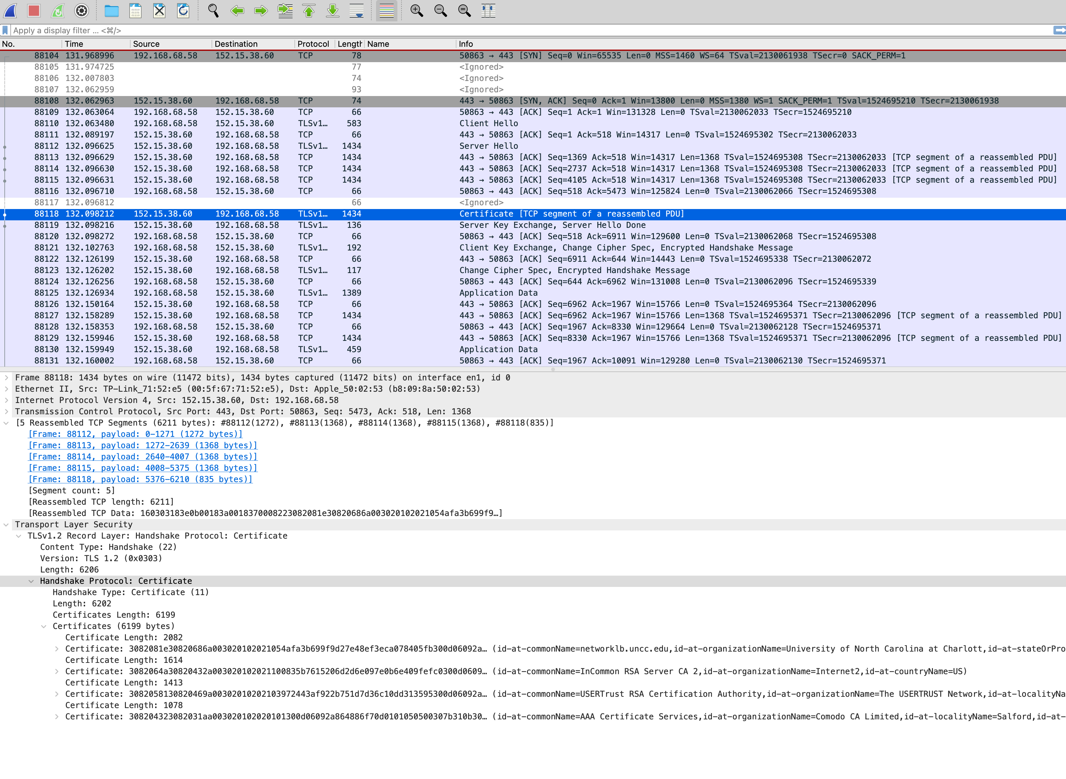
Notes:
1) What is the Client IP address, Server IP address, and their Port numbers?
2) For packet 88118, what will be the sequence number of the next TCP segment sent by the client?
3) According to the fragment reassembling, what is the MTU (maximum transmission unit) of the network, the head size of the TCP packet and the certificate size?

Slide 28
Chapter 3: roadmap
Transport-layer services
Multiplexing and demultiplexing
Connectionless transport: UDP
Principles of reliable data transfer
Connection-oriented transport: TCP
Principles of congestion control
TCP congestion control
Evolution of transport-layer functionality

Slide 29
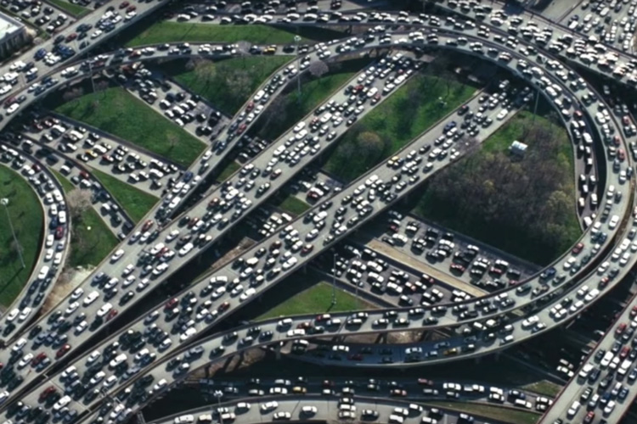
Principles of congestion control
Congestion:
informally: “too many sources sending too much data too fast for network to handle”
manifestations:
long delays (queueing in router buffers)
packet loss (buffer overflow at routers)
different from flow control!
congestion control: too many senders, sending too fast
a top-10 problem!
flow control: one sender too fast for one receiver

Slide 30
Causes/costs of congestion: scenario 1
original data: λ_{in}
throughput: λ_{out}
Simplest scenario:
Host A
one router, infinite buffers
input, output link capacity: R
infinite shared output link buffers
two flows
R
R
no retransmissions needed
Host B
R/2
Q: What happens as arrival rate λ_{in} approaches R/2?
λ_{out}
delay
throughput:
λ_{in}
R/2
λ_{in}
R/2
maximum per-connection throughput: R/2
large delays as arrival rate λινε approaches capacity
R/2

Slide 31
Causes/costs of congestion: scenario 2
one router, finite buffers
sender retransmits lost, timed-out packet
application-layer input = application-layer output: λ_{in} = λ_{out}
transport-layer input includes retransmissions : λ’_{in} λ_{in}
Host A
λ_{in} : original data
λ'_{in}: original data, plus retransmitted data
λ_{out}
R
R
Host B
finite shared output link buffers

Slide 32
Causes/costs of congestion: scenario 2
Idealization: perfect knowledge
sender sends only when router buffers available
R/2
λ_{out}
throughput:
Host A
λ_{in} : original data
λ_{in}
copy
λ'_{in}: original data, plus retransmitted data
λ_{out}
R/2
free buffer space!
R
R
Host B
finite shared output link buffers

Slide 33

Causes/costs of congestion: scenario 2
Idealization: some perfect knowledge
packets can be lost (dropped at router) due to full buffers
sender knows when packet has been dropped: only resends if packet known to be lost
Host A
λ_{in} : original data
copy
λ'_{in}: original data, plus retransmitted data
no buffer space!
R
R
Host B
finite shared output link buffers

Slide 34
Causes/costs of congestion: scenario 2
Idealization: some perfect knowledge
packets can be lost (dropped at router) due to full buffers
sender knows when packet has been dropped: only resends if packet known to be lost
R/2
λ_{out}
“wasted” capacity due to retransmissions
when sending at R/2, some packets are needed retransmissions
throughput:
Host A
λ_{in} : original data
λ_{in}
λ'_{in}: original data, plus retransmitted data
R/2
free buffer space!
R
R
Host B
finite shared output link buffers

Slide 35


Causes/costs of congestion: scenario 2
Realistic scenario: un-needed duplicates
packets can be lost, dropped at router due to full buffers – requiring retransmissions
but sender times can time out prematurely, sending two copies, both of which are delivered
R/2
λ_{out}
“wasted” capacity due to un-needed retransmissions
throughput:
when sending at R/2, some packets are retransmissions, including needed and un-needed duplicates, that are delivered!
Host A
λ_{in} : original data
λ_{in}
copy
λ'_{in}: original data, plus retransmitted data
R/2
timeout
free buffer space!
R
R
Host B
finite shared output link buffers

Slide 36
Causes/costs of congestion: scenario 2
Realistic scenario: un-needed duplicates
packets can be lost, dropped at router due to full buffers – requiring retransmissions
but sender times can time out prematurely, sending two copies, both of which are delivered
R/2
λ_{out}
“wasted” capacity due to un-needed retransmissions
throughput:
when sending at R/2, some packets are retransmissions, including needed and un-needed duplicates, that are delivered!
λ_{in}
R/2
“costs” of congestion:
more work (retransmission) for given receiver throughput
unneeded retransmissions: link carries multiple copies of a packet
decreasing maximum achievable throughput

Slide 37
Causes/costs of congestion: insights
throughput can never exceed capacity
delay increases as capacity approached
loss/retransmission decreases effective throughput
un-needed duplicates further decreases effective throughput

Slide 38
Approaches towards congestion control
End-end congestion control:
no explicit feedback from network
congestion inferred from observed loss, delay
ACKs
data
data
ACKs
approach taken by TCP

Slide 39
Approaches towards congestion control
Network-assisted congestion control:
routers provide direct feedback to sending/receiving hosts with flows passing through congested router
may indicate congestion level or explicitly set sending rate
explicit congestion info
ACKs
data
data
ACKs
TCP ECN, ATM, DECbit protocols

Slide 40
Chapter 3: roadmap
Transport-layer services
Multiplexing and demultiplexing
Connectionless transport: UDP
Principles of reliable data transfer
Connection-oriented transport: TCP
Principles of congestion control
TCP congestion control
Evolution of transport-layer functionality

Slide 41
TCP congestion control: AIMD
approach: senders can increase sending rate until packet loss (congestion) occurs, then decrease sending rate on loss event
Additive Increase
Multiplicative Decrease
increase sending rate by 1 maximum segment size every RTT until loss detected
cut sending rate in half at each loss event
AIMD sawtooth
behavior: probing
for bandwidth
TCP sender Sending rate
time

Slide 42
TCP AIMD: more
Multiplicative decrease detail: sending rate is
Cut in half on loss detected by triple duplicate ACK (TCP Reno)
Cut to 1 MSS (maximum segment size) when loss detected by timeout (TCP Tahoe)
Why AIMD?
AIMD – a distributed, asynchronous algorithm – has been shown to:
optimize congested flow rates network wide!
have desirable stability properties

Slide 43
TCP slow start
Host A
Host B
when connection begins, increase rate exponentially until first loss event:
initially cwnd = 1 MSS
double cwnd every RTT
done by incrementing cwnd for every ACK received
one segment
RTT
two segments
four segments
summary: initial rate is slow, but ramps up exponentially fast
time

Slide 44
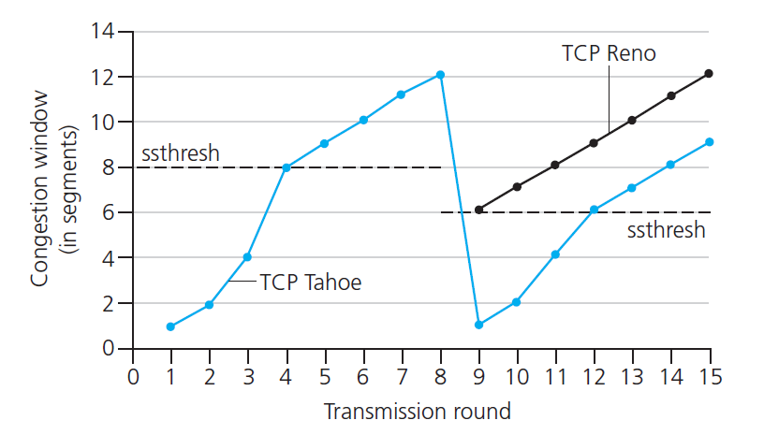

TCP: from slow start to congestion avoidance
Q: when should the exponential increase switch to linear?
A: when cwnd gets to 1/2 of its value before timeout.
X
Implementation:
variable ssthresh
on loss event, ssthresh is set to 1/2 of cwnd just before loss event

Slide 45
TCP congestion control
State | Event | TCP Sender Action | Commentary
Slow Start (SS) | ACK receipt for previously unacked data | CongWin = CongWin + MSS, If (CongWin > Threshold) set state to “Congestion Avoidance” | Resulting in a doubling of CongWin every RTT
Congestion Avoidance (CA) | ACK receipt for previously unacked data | CongWin = CongWin+MSS * (MSS/CongWin) | Additive increase, resulting in increase of CongWin by 1 MSS every RTT
SS or CA | Loss event detected by triple duplicate ACK | Threshold = CongWin/2, CongWin = Threshold, Set state to “Congestion Avoidance” | Fast recovery, implementing multiplicative decrease. CongWin will not drop below 1 MSS.
SS or CA | Timeout | Threshold = CongWin/2, CongWin = 1 MSS, Set state to “Slow Start” | Enter slow start
SS or CA | Duplicate ACK | Increment duplicate ACK count for segment being acked | CongWin and Threshold not changed

Slide 46
Summary: TCP congestion control
New
ACK!
New
ACK!
.
duplicate ACK
new ACK
dupACKcount++
new ACK
cwnd = cwnd + MSS (MSS/cwnd)
dupACKcount = 0
transmit new segment(s), as allowed
cwnd = cwnd+MSS
dupACKcount = 0
transmit new segment(s), as allowed
Λ
cwnd = 1 MSS
ssthresh = 64 KB
dupACKcount = 0
cwnd > ssthresh
slow
start
Λ
congestion
avoidance
timeout
ssthresh = cwnd/2
cwnd = 1 MSS
dupACKcount = 0
retransmit missing segment
duplicate ACK
timeout
dupACKcount++
ssthresh = cwnd/2
cwnd = 1 MSS
dupACKcount = 0
retransmit missing segment
timeout
New
ACK!
ssthresh = cwnd/2
cwnd = 1
dupACKcount = 0
retransmit missing segment
New ACK
dupACKcount == 3
cwnd = ssthresh
dupACKcount = 0
dupACKcount == 3
ssthresh= cwnd/2
cwnd = ssthresh + 3
retransmit missing segment
ssthresh= cwnd/2
cwnd = ssthresh + 3
retransmit missing segment
fast
recovery

Slide 47
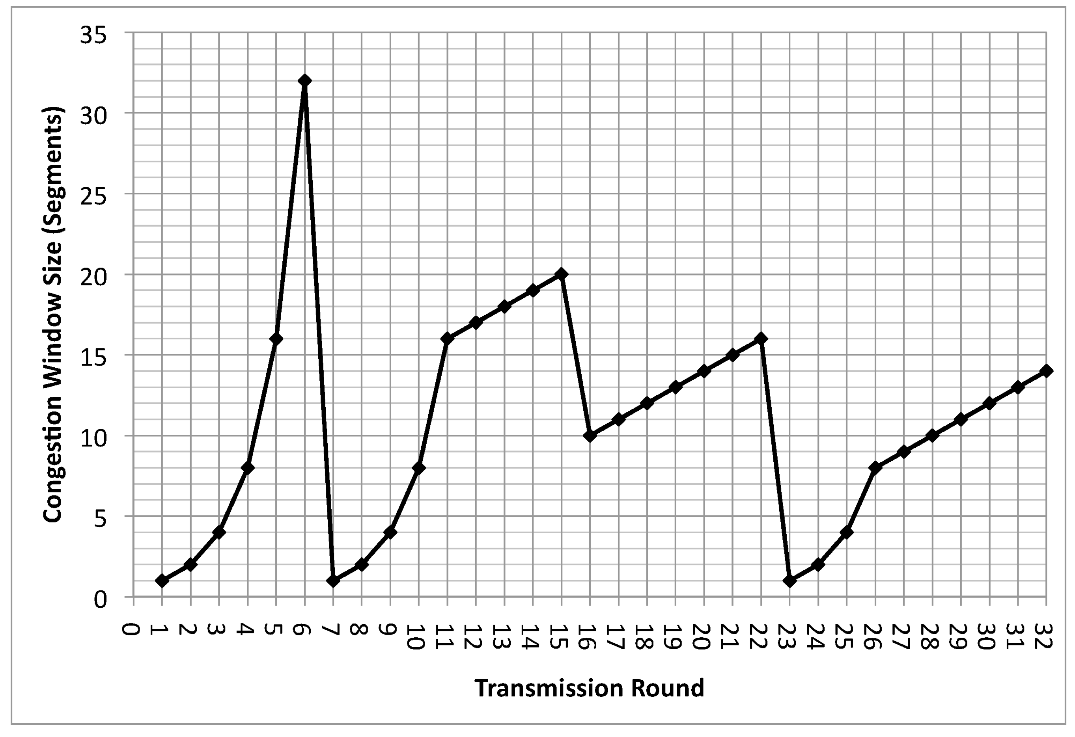
Questions
a) Illustrate when timeout events happen in the figure. b) Compare slow start and congestion avoidance. Give two reasons why slow start is used, and when slow start does a better job. c) Identify the intervals when slow start is used in the above figure. Identify which of the above reasons apply for each interval, why. (d) Identify the intervals when congestion avoidance is used. Illustrate why it is used instead of slow start in these intervals. (e) Identify the intervals when fast retransmission is used. Illustrate why and how it is used.

Slide 48
TCP and the congested “bottleneck link”
TCP (classic, CUBIC) increase TCP’s sending rate until packet loss occurs at some router’s output: the bottleneck link
understanding congestion: useful to focus on congested bottleneck link
insight: increasing TCP sending rate will not increase end-end throughout with congested bottleneck
source
destination
application
TCP
network
link
physical
application
TCP
network
link
physical
insight: increasing TCP sending rate will increase measured RTT
Goal: “keep the end-end pipe just full, but not fuller”
RTT

Slide 49
Delay-based TCP congestion control
Keeping sender-to-receiver pipe “just full enough, but no fuller”: keep bottleneck link busy transmitting, but avoid high delays/buffering
# bytes sent in last RTT interval
RTT_{measured}
measured
throughput
=
RTT_{measured}
Delay-based approach:
RTT_{min} - minimum observed RTT (uncongested path)
uncongested throughput with congestion window cwnd is cwnd/RTT_{min}
if measured throughput “very close” to uncongested throughput
increase cwnd linearly /* since path not congested */
else if measured throughput “far below” uncongested throughout
decrease cwnd linearly /* since path is congested */

Slide 50
Delay-based TCP congestion control
congestion control without inducing/forcing loss
maximizing throughout (“keeping the just pipe full… ”) while keeping delay low (“…but not fuller”)
a number of deployed TCPs take a delay-based approach
BBR deployed on Google’s (internal) backbone network

Slide 51
Explicit congestion notification (ECN)
TCP deployments often implement network-assisted congestion control:
two bits in IP header (ToS field) marked by network router to indicate congestion
policy to determine marking chosen by network operator
congestion indication carried to destination
destination sets ECE bit on ACK segment to notify sender of congestion
involves both IP (IP header ECN bit marking) and TCP (TCP header C,E bit marking)
source
TCP ACK segment
destination
application
TCP
network
link
physical
application
TCP
network
link
physical
ECE=1
ECN=10
ECN=11
IP datagram

Slide 52
TCP fairness
Fairness goal: if K TCP sessions share same bottleneck link of bandwidth R, each should have average rate of R/K
TCP connection 1
bottleneck
router
capacity R
TCP connection 2

Slide 53
Q: is TCP Fair?
Example: two competing TCP sessions:
additive increase gives slope of 1, as throughout increases
multiplicative decrease decreases throughput proportionally
R
equal bandwidth share
Is TCP fair?
A: Yes, under idealized assumptions:
same RTT
fixed number of sessions only in congestion avoidance
loss: decrease window by factor of 2
congestion avoidance: additive increase
Connection 2 throughput
loss: decrease window by factor of 2
congestion avoidance: additive increase
Connection 1 throughput
R

Slide 54
Transport layer: roadmap
Transport-layer services
Multiplexing and demultiplexing
Connectionless transport: UDP
Principles of reliable data transfer
Connection-oriented transport: TCP
Principles of congestion control
TCP congestion control
Evolution of transport-layer functionality

Slide 55
Evolving transport-layer functionality
TCP, UDP: principal transport protocols for 40 years
different “flavors” of TCP developed, for specific scenarios:
Scenario | Challenges
Long, fat pipes (large data transfers) | Many packets “in flight”; loss shuts down pipeline
Wireless networks | Loss due to noisy wireless links, mobility; TCP treat this as congestion loss
Long-delay links | Extremely long RTTs
Data center networks | Latency sensitive
Background traffic flows | Low priority, “background” TCP flows
moving transport–layer functions to application layer, on top of UDP
HTTP/3: QUIC

Slide 56
QUIC: Quick UDP Internet Connections
application-layer protocol, on top of UDP
increase performance of HTTP
deployed on many Google servers, apps (Chrome, mobile YouTube app)
HTTP/2
HTTP/2 (slimmed)
Application
HTTP/3
TLS
QUIC
Transport
TCP
UDP
Network
IP
IP
HTTP/2 over TCP
HTTP/2 over QUIC over UDP

Slide 57
QUIC: Quick UDP Internet Connections
adopts approaches we’ve studied in this chapter for connection establishment, error control, congestion control
error and congestion control: “Readers familiar with TCP’s loss detection and congestion control will find algorithms here that parallel well-known TCP ones.” [from QUIC specification]
connection establishment: reliability, congestion control, authentication, encryption, state established in one RTT
multiple application-level “streams” multiplexed over single QUIC connection
separate reliable data transfer, security
common congestion control

Slide 58
QUIC: Connection establishment
TCP handshake
(transport layer)
QUIC handshake
data
TLS handshake
(security)
data
TCP (reliability, congestion control state) + TLS (authentication, crypto state)
2 serial handshakes
QUIC: reliability, congestion control, authentication, crypto state
1 handshake

Slide 59
QUIC: streams: parallelism, no HOL blocking
HTTP
GET
HTTP
GET
HTTP
GET
HTTP
GET
HTTP
GET
application
HTTP
GET
QUIC
encrypt
QUIC
encrypt
QUIC
encrypt
QUIC
encrypt
QUIC
encrypt
QUIC
encrypt
TLS encryption
TLS encryption
QUIC
RDT
QUIC
RDT
QUIC
RDT
QUIC
RDT
QUIC
RDT
QUIC
RDT
error!
QUIC Cong. Cont.
QUIC Cong. Cont.
TCP RDT
TCP RDT
error!
transport
TCP Cong. Contr.
TCP Cong. Contr.
UDP
UDP
(a) HTTP 1.1
(b) HTTP/2 with QUIC: no HOL blocking

Slide 60
Chapter 3: summary
principles behind transport layer services:
multiplexing, demultiplexing
reliable data transfer
flow control
congestion control
instantiation, implementation in the Internet
UDP
TCP
Up next:
leaving the network “edge” (application, transport layers)
into the network “core”
two network-layer chapters:
data plane
control plane

